Slide 1
Sorting Techniques

Slide 2
Sorting
Sorting is the process of arranging a set of data in certain order.
Internal Sorting
Deals with sorting the data held in memory of the computer
External Sorting
Deals with sorting the data stored in data files, it is used when volume of data is very large and cannot be held in computers main memory
Some of the sorting algorithms are
Selection sort
Bubble sort
Insertion sort
Quick sort
Radix sort
Merge sort
Bucket sort
Tree sort

Slide 3
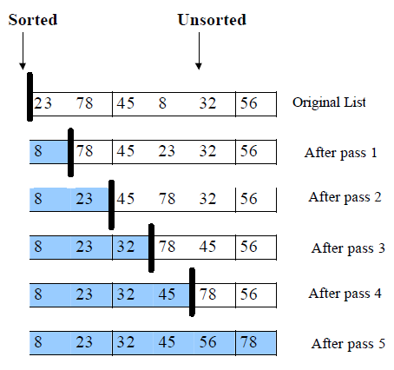
Selection Sort
Process Flow:
Read array size.
Read an array of values.
Sort the given array.
Print sorted values.

Slide 4
Selection Sort
Finding smallest in each iteration
Begin
set small = a[k-1]
set loc = k-1
for j = k to (n-1) by 1 do
if (a[j]< small) then
set small = a[j]
set loc = j
end if
end for
End

Slide 5
Selection Sort
Void SelectionSort(int a[], int n)
{
int temp, small, loc, I, j;
For (i=1;i<=(n-1);i++)
{
small = a[i-1];
Loc=i-1;
For (j=i; j<=(n-1);j++)
{
If(a[j]<small)
{
Small=a[j];
Loc=j;
}
}
If(loc !=(i-1) {
temp=a[i-1];
a[i-1]=a[loc];
a[loc]= temp;
}
}
}
Analysis
F(n) = (n-1) +(n-2) +………+/3 +2+1
= n (n-1 ) / 2
= O (n² )

Slide 6
Bubble Sort
Bubble sort is a simple and well-known sorting algorithm.
Bubble sort belongs to O(n²) sorting algorithms, which makes it quite inefficient for sorting large data volumes.
Bubble sort is stable and adaptive.
Algorithm
Compare each pair of adjacent elements from the beginning of an array and, if they are in reversed order, swap them.
If at least one swap has been done, repeat step 1.

Slide 7
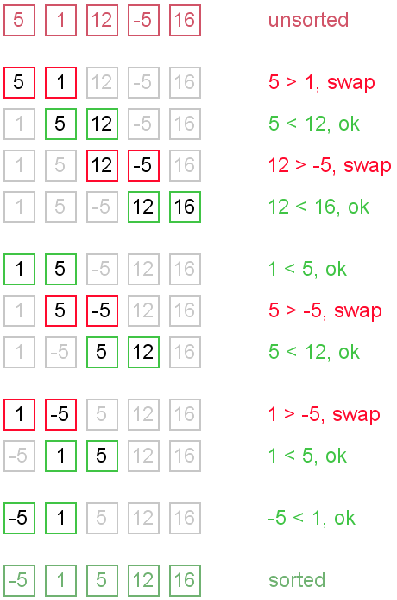
Bubble Sort

Slide 8
Bubble Sort
Begin
for k = 1 to (n-1) by 1 do
for j = 0 to (n-k-1) by 1 do
If ( a[j] > a[j+1] ) then
temp = a [j]
a[j] = a [j+1]
a[j+1]= temp
End if
End for
End for
End
Analysis
F(n) = (n-1) +(n-2) +………+/3 +2+1
= n (n-1 ) / 2
= O (n² )

Slide 9
Insertion Sort
Insertion sort belongs to the O(n²) sorting algorithms.
Unlike many sorting algorithms with quadratic complexity, it is actually applied in practice for sorting small arrays of data.
Algorithm
Insertion sort algorithm resembles selection sort.
Array is imaginary divided into two parts - sorted one and unsorted one.
At the beginning, sorted part contains first element of the array and unsorted one contains the rest.
At every step, algorithm takes first element in the unsorted part and inserts it to the right place of the sorted one.
When unsorted part becomes empty, algorithm stops.

Slide 10


Insertion Sort
Example: Sort {7, -5, 2, 16, 4} using insertion sort.

Slide 11
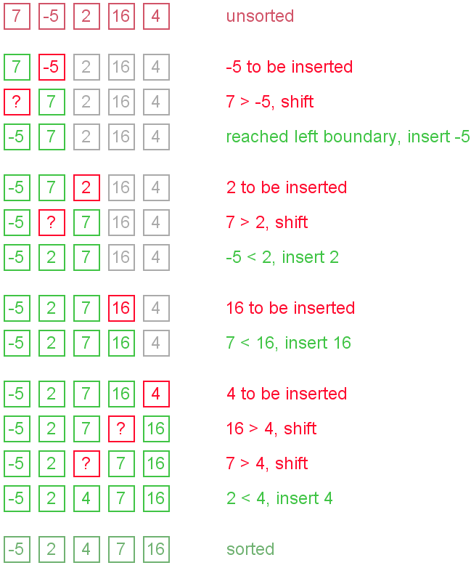
Insertion Sort

Slide 12
Analysis [no of comparisons ]
F(n) = 1 + 2 + 3 + ………(n-3) +(n-2)+ (n-1)
= n (n-1 ) / 2
= O (n² )
Insertion Sort (A)
for j=2 to A.length
key = A[j]
//insert A[j] into sorted sequence A[1..j-1]
i=j-1
while (i>0 and A[i] > key )
A[i+1] =A [i]
i=i-1
A[i+1]= key
End for

Slide 13
Video Lecture of the topic can be found at
Selection Sort
https://youtu.be/UAVK_GcpLCw
Bubble Sort
https://youtu.be/EQx9mgyD9Vc
Insertion Sort
https://youtu.be/f6imAhX3Fqo

